Slide 1
Elastography scripts structure.
Videos to process and results
List of files to process and parameters
Main file to run in matlab
V1.1

Slide 2
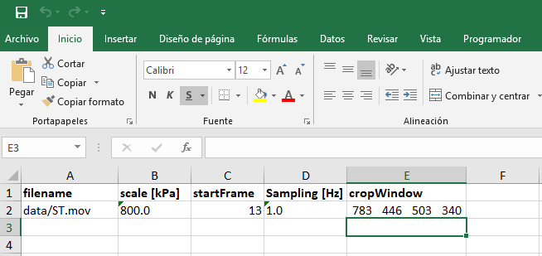
Running runMe.m file
1.- Edit the “inputVideos.xlsx” excel file. For instance add all the videos you want to process (you can write folders). In this example we process two videos:
2.- Note that the first video is inside the folder “data” and it is a mpg file. The scale appears on top of the elastosonography scale bar, the startFrame is to remove some frames (a typical video has 25 frames per second, so 13 is about 13/25 seconds offset). Sampling is the frequency of the elastosonography which should be slower than ultrasound. cropWindow is the ROI were measurements Will be made (see how to get these number at the end of this document)

Slide 3
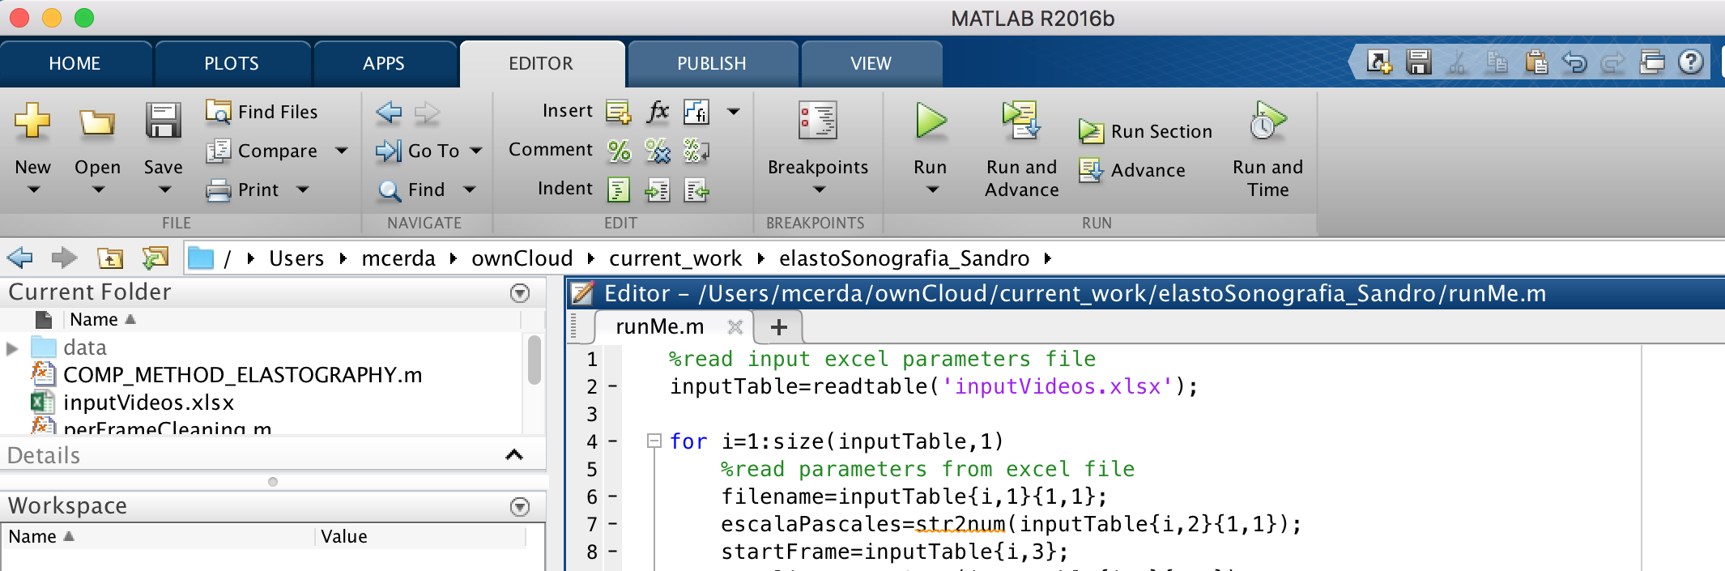
Running runMe.m file
3.- Open the runMe.m file from matlab (red) and run the script (blue):

Slide 4
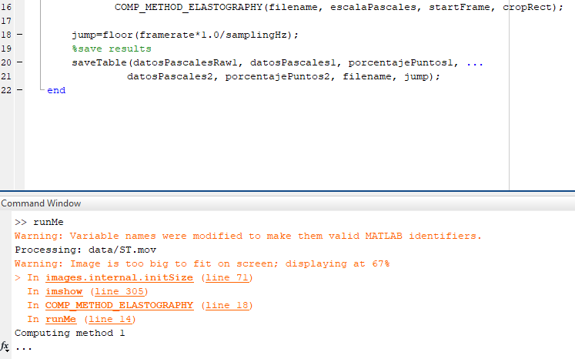
Running runMe.m file
4.- Note that while running there is no graphical interface or interaction (just a reference image is briefly shown to indicate the elastosonography general ROI) but console information about processing is shown (red circle):

Slide 5
Running runMe.m file
5.- If the processing is ok, one excel file is created per video:
Input video
Result table

Slide 6
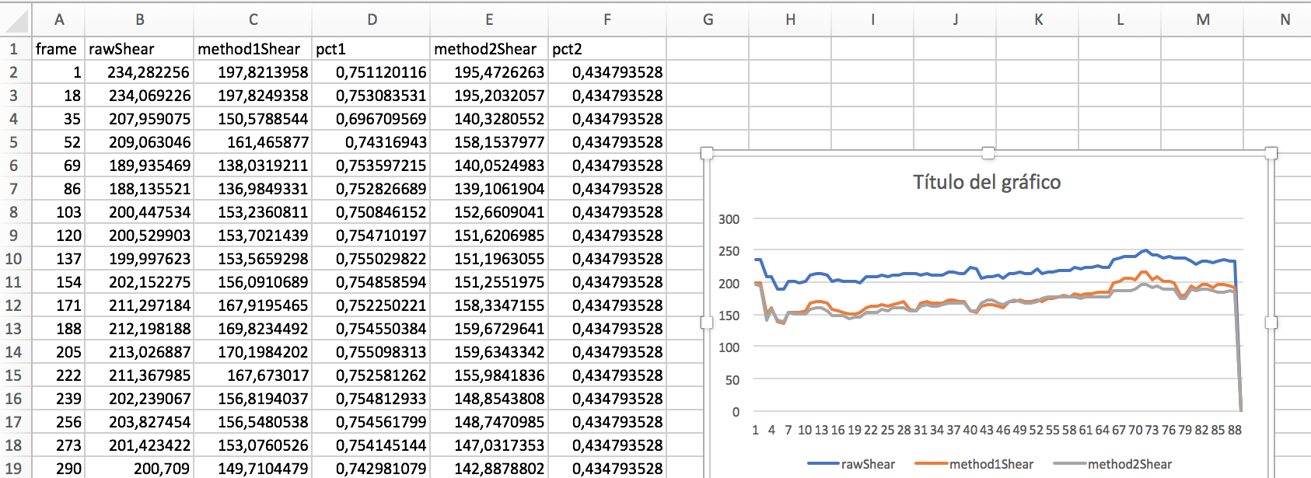
Running runMe.m file
7.- Each result excel file will look like the figure (plot is not automatic).
rawShear is the mean value in kPa of all pixel in the elastosonography (no pixel removal strategy).
method1Shear dinamically selects no-black pixels inside the elastosonography and deliver the mean value in kPa in those pixels only.
Pct1 is the % of pixel used in method1Shear estimation.
method2Shear selects the set of pixels that are non-black during the full record and deliver the mean value in kPa in those pixels only.
Pct2 is the % of pixel used in method2Shear estimation (always fix)

Slide 7
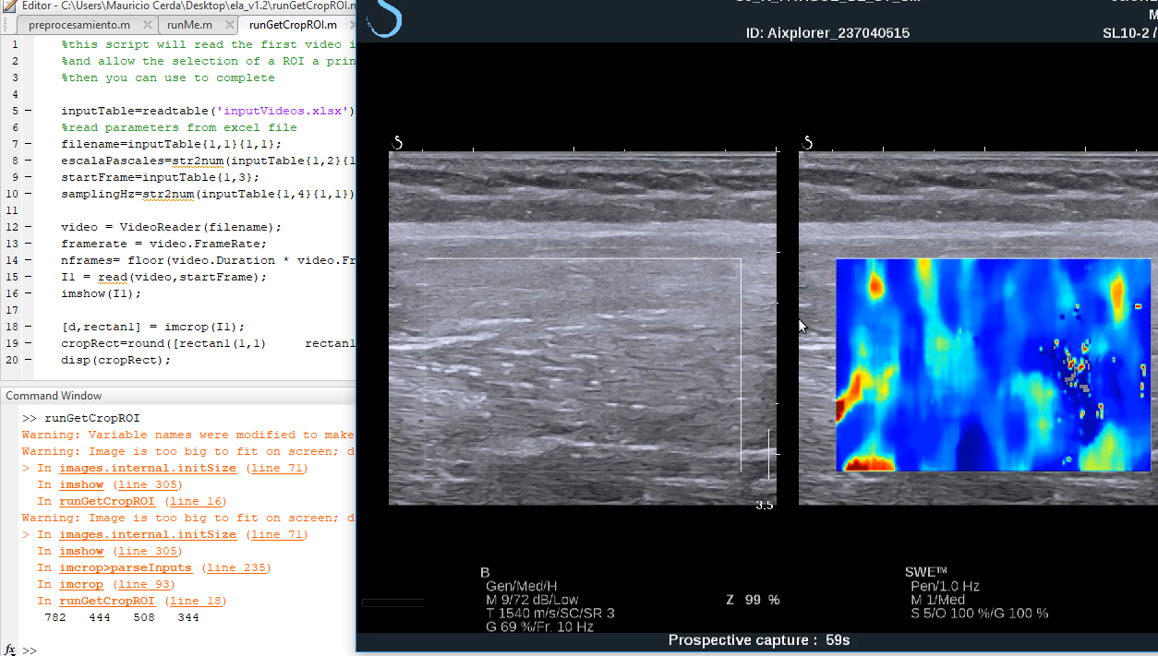
ROI estimation
1.- Open the “runGetCropROI.m” file in Matlab.
2.- This script Will only show the first frame of the first video in the input Excel file, allow the use to select a rectangular ROI and show the ROI result (4 numbers) as shown below.
3.- Copy those 4 numbers to the right row in the input file in order to process.

